Slide 1
#TwitterSearch: A Comparison Of Microblog Search And Web Search (WSDM’11)
Speaker:Chiang,guang-ting
Advisor: Dr. Koh. Jia-ling

Slide 2
INDEX
Introduction
Why people search twitter
How people search twitter
What people find on twitter
Design implication
Conclusion
My personal thinking…..

Slide 3
Introduction
Social networking Web sites are not just places to maintain relationships; they can also be valuable information sources.
Very little is understood about what motivates people to search on Microblog, and about how such search behavior differs from traditional Web search engines.

Slide 4
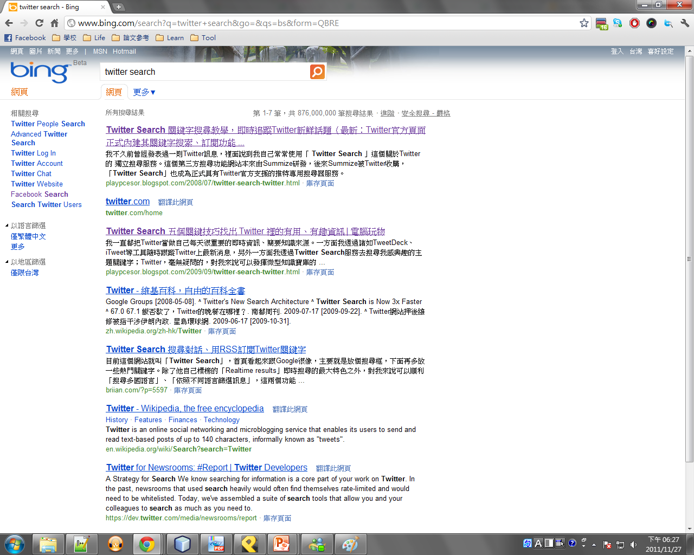
Ordered by relevance
Extractd words from text

Slide 5
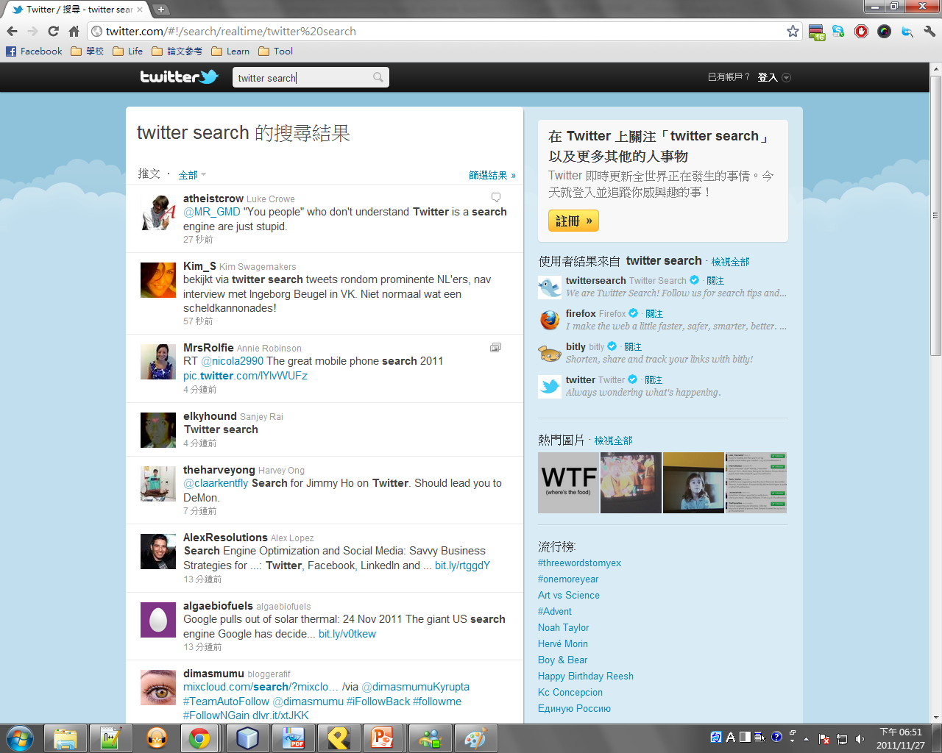
Ordered by time
The whole content ( 140 characters)

Slide 6
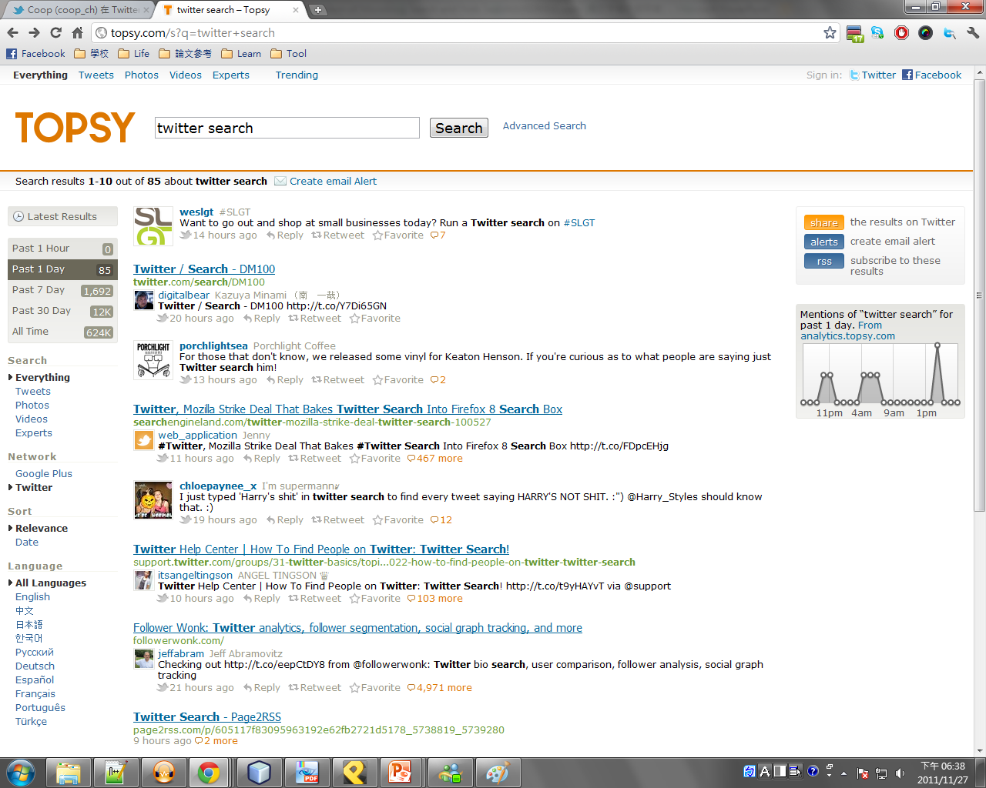

Slide 7
Introduction
Demo

Slide 8
Why people search twitter
Survey of 54 microsoft twitter users
Timely information
News(e.q.,”technology news, trends…”)
Real-time info.(e.q., “weather, traffic jam…”)
Social information
Finding some users(@JustinBier_love )
People’s overall openions(e.q, “賽德克巴萊…”)
Topical information
Like traditional web search
“follow”

Slide 9
Twitter search vs. Web search
twitter | web
Monitor content | Develop or learn about a topic
Common, basic | Basic facts
Temporally relevance information | Navigational content
Information related to people

Slide 10
Methodology
Query log analysis (use a Being Toolbar)
Twitter queries issued to http://twitter.com
Sample of 33k users over 2 weeks
126k queries
Web queries issued to Bing, Google and Yahoo!
For the users who issued twitter queries
2.5 million queries
Comparison of search results

Slide 11
How people search twitter
Queries issued
Temporal patterns
Cross-corpus behavior

Slide 12
Top web queries issued
Top web queries navigational
Biased towards social networking sites bcz of the user sample
Web
twitter
youtube
facebook
google
myspace
youtube.com
yahoo
ebay
craigslist
myspace.com

Slide 13
Top twitter queries issued
People-focused
Specialized syntax
Temporal aspects
Web | Twitter
twitter | New moon
youtube | #youknowyouruglyif
facebook | Justin bieber
google | Adam lambert
myspace | #theresway2many
youtube.com | Taylor swift
yahoo | Lady gaga
ebay | Modern warfare 2
craigslist | Thanksgiving
myspace.com | #wecoolandallbut

Slide 14
People in twitter queries
Lots of celebrity names
Lady gaga
Celebrities unlikely to just be part of a query
Lady gaga is a man
Many references to individual user accounts
 | web | twitter
Is a celebrity name | 3.1% | 15.2%
Mentions a celebrity | 14.9% | 6.5%
Contains @ | 0.1% | 3.4%
Is a username without@ | 0.0% | 2.4%
Contains # | 0.1% | 21.3%

Slide 15
Twitter syntax :@ and #
Specialized syntax very common for Twitter
@ and # reduce ambiguity like advanced query operators
Important differences:
Part of content creation
Hashtag queries often issued via a click
 | web | twitter
Is a celebrity name | 3.1% | 15.2%
Mentions a celebrity | 14.9% | 6.5%
Contains @ | 0.1% | 3.4%
Is a username without@ | 0.0% | 2.4%
Contains # | 0.1% | 21.3%

Slide 16
Twitter Query Popularity
Hashtag queries particularly popular
Most popular(Top 50) queries:
Hashtag 51% of the time
Least popular(Occure once) queries:
Hashtag 7% of the time
Celebrity queries particularly popular
Most popular queries: Celebrity 25% of the time
Least popular queries: Celebrity 4% of the time

Slide 17
Temporal Patterns on Twitter
Individuals repeat the same query on Twitter
35% of Web queries are repeat(re-finding)
56% of Twitter queries are repeat
But sessions are shorter
A session is a series of queries issued by an individual in close succession, often (but not always) with all queries being related to the same topic.
 | web | twitter
Number of queries in session | 2.9 | 2.2
Number of unique queries in session | 2.67 | 1.5
Seconds between queries in session | 13.6 | 9.4

Slide 18
Cross-Corpus Behavior
Some users issued same query to Twitter & Web
Overlapping queries highly informational
Web used to explore
Twitter used to monitor
query | corpus
new moon | twitter
#new moon | twitter
new moon | web
new moon | twitter
watch new moon full movue | web
new moon whole movie online | web
watch new moon full movie | web

Slide 19
What people find on twitter
Collecting twitter and web results
Twitter’s spritzer
1 week
8 million posts
50 most common queries
Twitter’s result
Present entire content of each result in the result list
Web’s result
presented as a list of hyperlinks, each with an algorithmically extracted snippet of text designed to help the searcher select which hyperlink to visit

Slide 20
What people find on twitter
Language difference in results
Use Latent Dirichlet Allocation (LDA) , a popular unsupervised latent variable topic model from the machine learning technology
D1
T1
T1:w1, w2, w3…
D1:t1, t2
D2
T2:w1, w3, w5, w7…
D2:t2
T2
D3
T3:w2, w4, w6…
D3:t1, t3
T3
D4:t1, t3
D4
Use these feature learn, then computing the similarity.

Slide 21
What people find on twitter
social chatter and current events
Query : lady gaga
 | Description | Top words
twitter | Social chatter about Lady Gaga | what you url but looks about rt weird do now she's will man omg wearing say listening hell bitch lmao
 | 2009 American Music Awards performance | url adam ama 2009 performance want lol so lambert amas awardsrihanna americanwatching tonight ama's im happy ladygaga award
web | Biographical info about Stefani Joanne Angelina Germanotta | an her wikipedia stage germanotta after better Stefani name by joanne interscope American encyclopedia artist performing angelina records free known
 | Music-related multimedia content | listen mp3 free videos gaga's mp3s pop downloads watch myspace download streaming yahoo singles read profile pictures click per every
basic facts and navigational results

Slide 22
Design implications
Enriching People Search
Incorporating more information into either result page
Leveraging Hashtags
Can expose tags like twitter does: as clickable links that run new query(#topic).
Employing User History
Build personalize query history.bcz some user use query repeated.

Slide 23
Conclusion
twitter | web
Time important | Often navigational
People important | Time and people less important
Specialized syntax | No syntax use
Queries common | Queries longer
Repeated a lot | Queries develop
Change very little

Slide 24
My personal thinking…
This database is vary different with google, bing….
Product openion
News analysis
Recommandation system
blog
Microblog

